Slide 1
AWS -1

Slide 2
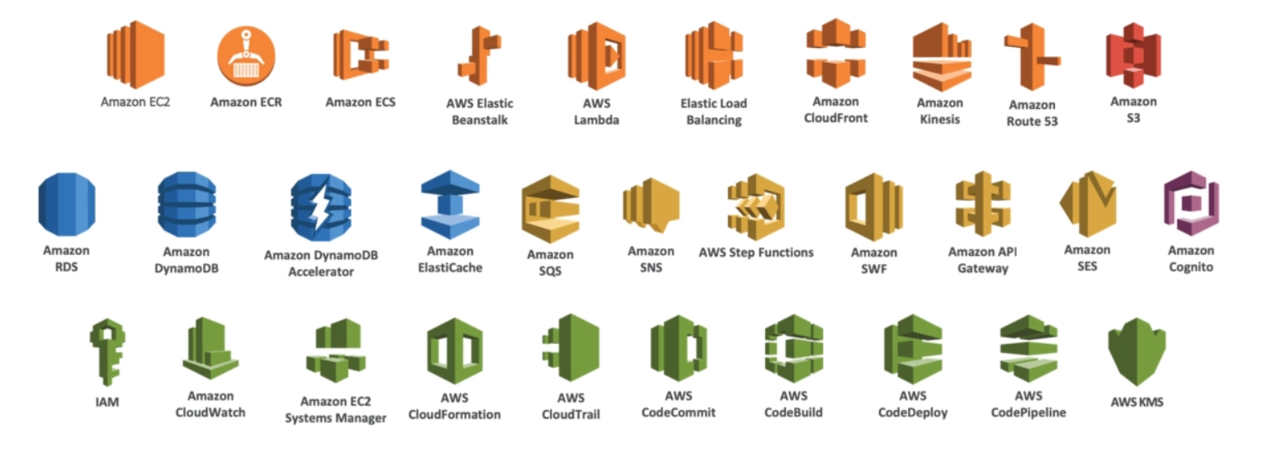
Course Contents

Slide 3
AWS Account for free
What’s in the free quota
https://aws.amazon.com/free/
Sign up process –credit card and phone info
My billing dashboard → restrict billing before we proceed

Slide 4
AWS Geographical distribution
AWS has several regions across the globe
Each region has multiple availability zones
AWS console is region scoped except IAM and S3
Work in a region closest to you (you here may be client, company etc)
https://aws.amazon.com/about-aws/global-infrastructure/

Slide 5
Introduction to IAM
Identity Access Management
Users (single person)
Groups (group of users, a team in general)
Roles (internal usage for AWS resources…only for machines / resources)
Policies (building blocks of users, groups and roles)
DoNot use Root User Account except for the first time
Limelight of AWS
Internal security of AWS is handled here
Can have MFA for users/Root accout
Managed Policies → already created policies to ease our effort

Slide 6
IAM Federation
Enterprise level setup usually integrate their users with IAM Federated accounts.
So that they can use their company credentials (SAML standard)
Temproray creds along with SSO will make a successful login.
Never share your IAM credentials / never use IAM creds in code directly

Slide 7
EC2
Renting VMs on cloud
Different renting strategies
Use VMs at flexibility
Scaling services automatically
Distributing Load across machines

Slide 8
Security groups
They control:
Access to ports
Authorised IP ranges (IPV6 supported)
Control over inbound network (from other to instance)
Control over outbound network (from instance to other)
Firewall of EC2 instances

Slide 9
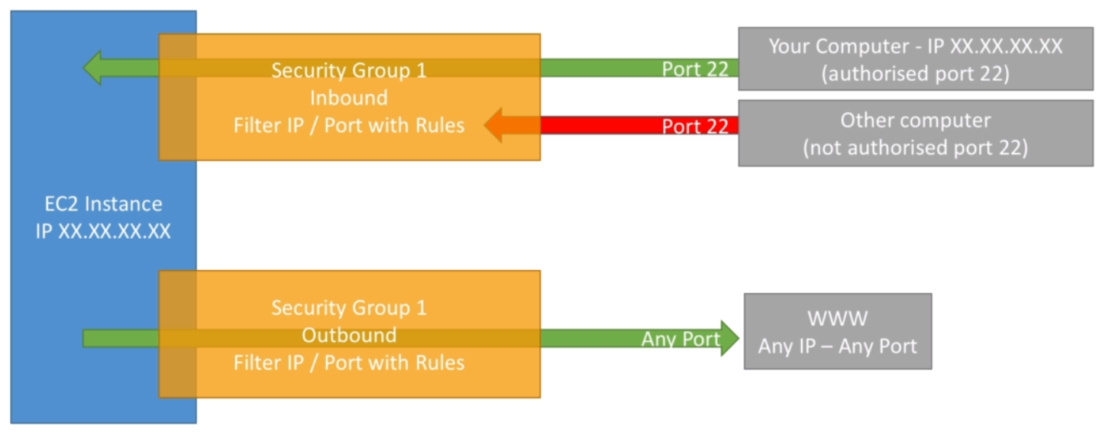

Slide 10
Can be attached to multiple instances
Segregated at region/VPC level
Live outside EC2 → if traffic is blocked the EC2 cannot know it
Good to maintain one dedicated separate security group for SSH
If application is not accessible because of timed out then it is security group issue
If application gives connection refused then something went wrong with application launch
All inbound traffic is blocked and all outbound traffic is allowed by default

Slide 11
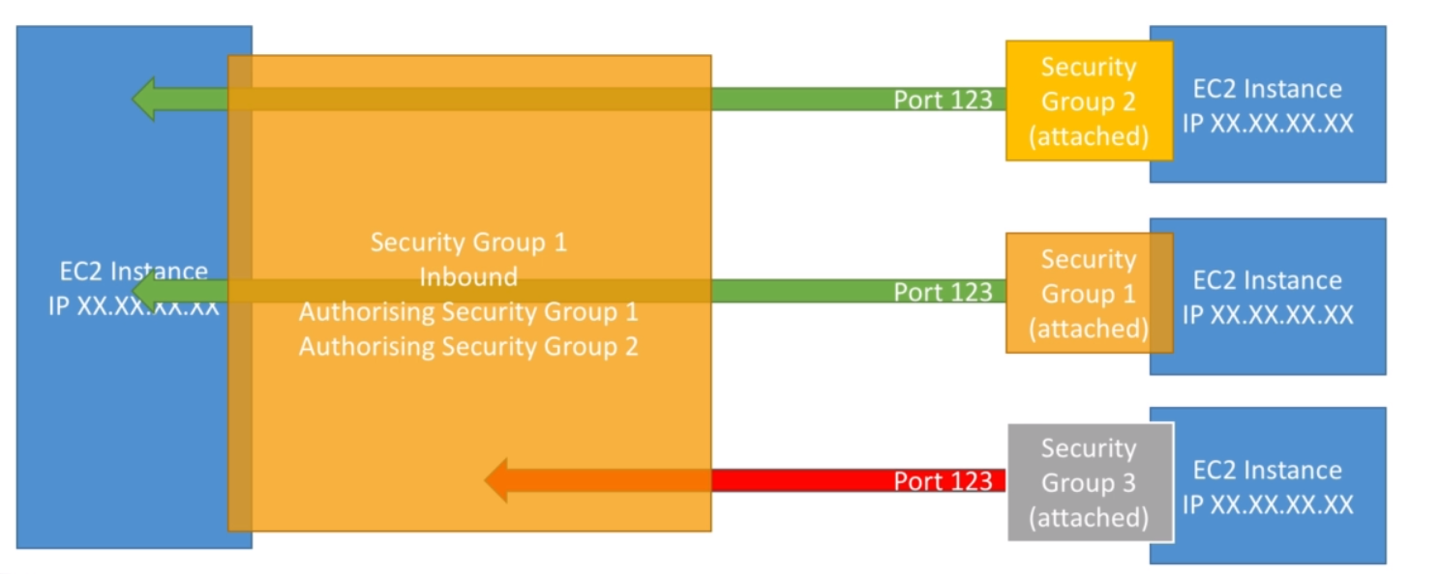
Referencing security groups from other security groups

Slide 12
Public vs Private IP
IPv4 → four numbers with 3 dots :p
Each block/number can have something between 0-255
IPv6 → 2001:0db8:85a3:0000:0000:8a2e:0370:7334
Public IP → used to identify a machine in internet
Must be unique across the globe
Private IP → can be identified inside private network
Unique in that private network but two different private networks can have same IPs
Machines can connect to internet using internet gateway (a proxy)
Only specified range can be used for Private IP

Slide 13
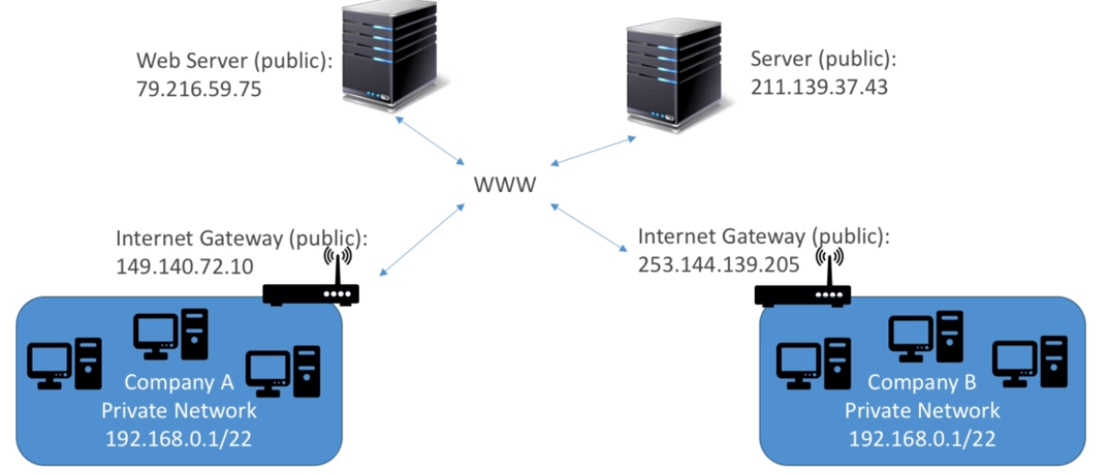

Slide 14
Elastic IP
Fixed public IP for EC2 Instance
Public IPv4 and we own it as long as we don’t delete it
Can be attached to one instance at a time
Mask the failure of an instance by rapidly remapping the address to another instance in your account.
By default we can have only 5 elastic Ips per account. We can increase the number by following up with support.
Try avoid using Elastic IP as it reflect poor architectural decisions.
Use a random public IP and attach a DNS to it or use ELB where in we don’t have to use public IP at all

Slide 15
EC2 Instances
On Demand Instances : Short workload, predictable pricing
Reserved Instances : Long workloads(>=1 year)
Convertible Reserved Instances : Long workloads with flexible instances
Scheduled Reserved Instances : Launch within time window we reserve
Spot Instances : Short workloads, for cheap, can lose instances.
Dedicated Instances : No other customers will share our hardware
Dedicated Hosts : Book an entire physical server, control instance placement.

Slide 16
On Demand → amazing to use with autoscaling
Reserved → 75% discount on On-Demand, Pay upfront for what you use with long term commitment → recommended for steady state usage like having database
Convertible Reserved Instance → 54% discount, Instance type can be changed
Scheduled Reserved Instances → dry runs, prod runs, test runs etc
Spot Instances → upto 90% discount compared to on demand, bid a price and get the instance as long as it’s price is under the bid price, when we get bid value more we lose instance.
We have 2 min notification warning when bid price goes up
Used for batch jobs, Big Data Analysis or workloads that are resilient to failures
Not for critical jobs
Dedicated hosts → more expensive, useful for software that have complicated licensing model (BYOL)
Dedicated Instances → hardware is not permanent when we stop and start

Slide 17
Instance Types → Main Ones
R → applications that needs a lot of RAM → In memory caches, In memory databases
C→ compute→ applications that needs good CPU → compute/databases
M : Applications that are balanced → medium may be → general/ web app
I : Applications that need good local I/O (instance storage) → databases
G: Apps that need a GPU → video rendering / Machine Learning
T2/T3 : Burstable instances (up to a capacity)
T2/T3: unlimited → unlimited burst

Slide 18
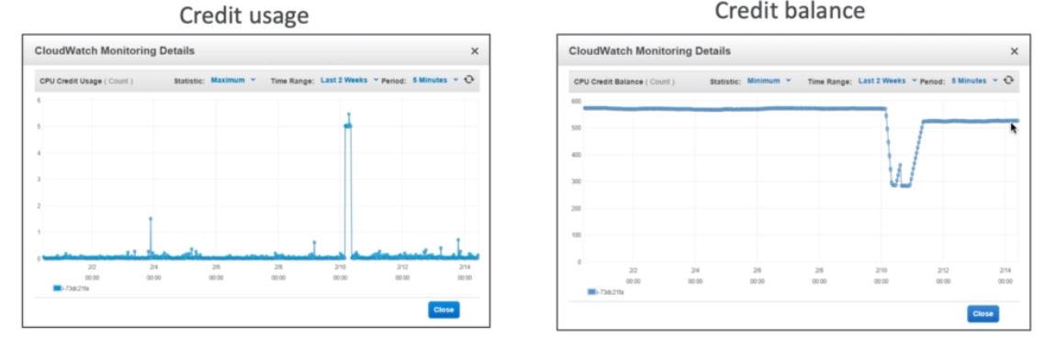
Burstable instances
During a spike in your load your CPU can boost as burst is activated.
If the machine bursts, it utilizes burst credits
If all credits are gone, CPU becomes bad
If machine stops bursting credits are accumulated over time
If your instance consistently runs low on credit, you need to move to a different kind of non-burstable instance

Slide 19
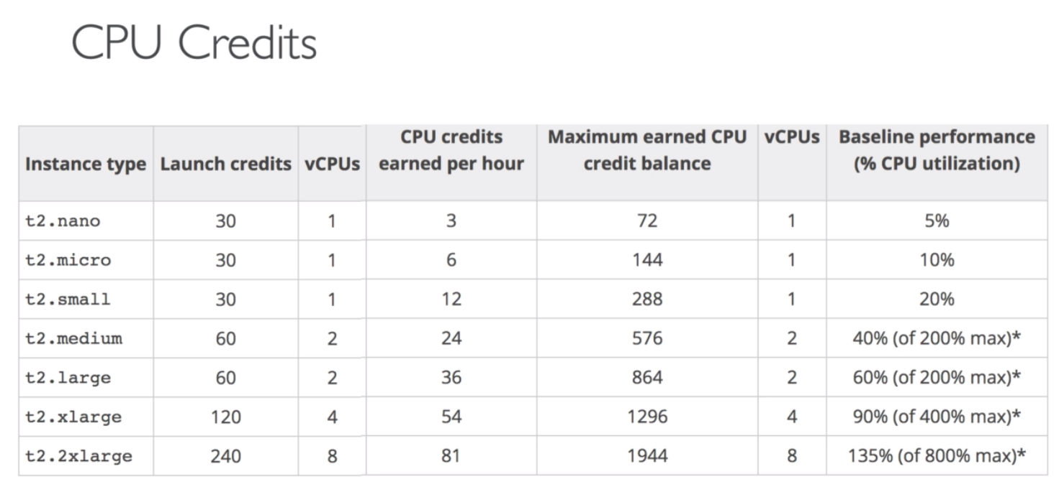

Slide 20
T2/T3 Unlimited
Nov 2K17 : possible to have unlimited credits
Pay extra money if we go over credit balance but we don’t lose performance

Slide 21
AMI
Base images are many
These images can be customised at runtime using EC2 userdata
We can create our own AMI for windows and linux
Pre installed packages
Faster boot time
Machine comes configured with monitoring
Security concerns – control over machines in the network
Control over maintanence and updates of AMI’s over time
Active Directory Integration out of the box
Installing an app ahead of time
Use other’s AMI that is optimised for some functionality

Slide 24
Placement groups
Sometimes we might want control over the EC2 instance placement strategy
That strategy can be defined using placement groups
When you create a placement you specify one of the following strategies for the group:
Cluster → cluster instances into a low latency group in a single availability zone
Spread → spreads instances across underlying hardware (max 7 instances per group per AZ)
Not Applicable to T2 instances

Slide 25
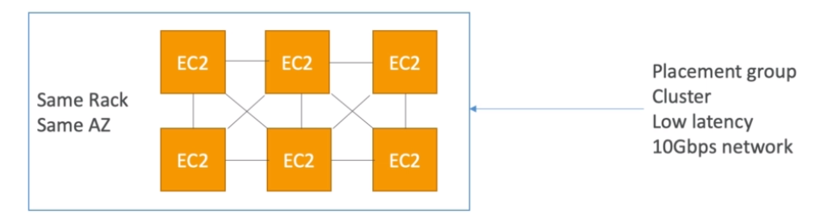
Cluster type

Slide 26
All EC2 are on same hardware
In same AZ
Low latency
Great network (10Gbps bandwidth between instances)
If the rack fails all instances fail at the same time
Use case : Big Data job that needs to complete fast
Application that needs extremely low latency and high network throughput

Slide 27
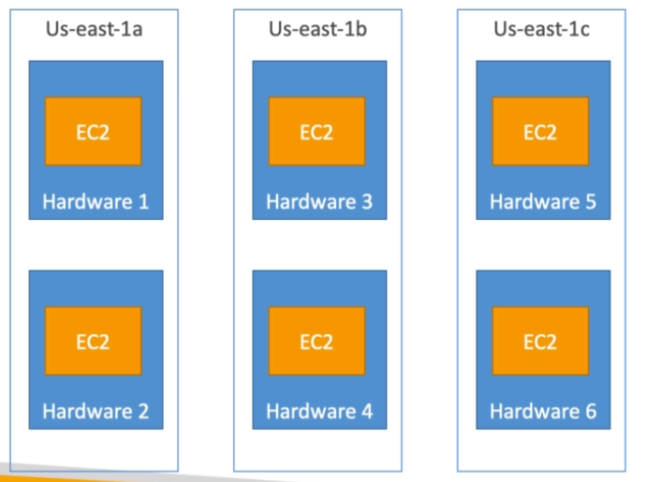
Spread strategy

Slide 28
Span across multiple AZ
Reduced risk of simultaneous failure
EC2 instances are on different physical hardware
Limited to 7 instances per AZ per placement group
Use case → Application that needs high availability
Cassandra cluster, Kafka Cluster, Web application that is distributed

Slide 29
EC2 Summary
EC2 instances are billed by the second, t2.micro is free tier (certain hours per month)
On Linux/Mac/ windows we can use SSH, in windows we can use Putty
SSH is on port 22, lock down the security group to your IP
Timeout issues → security group issue
Permission issues on SSH key → run chmod 400 on key
Security groups can reference other security groups instead of IP ranges
Public IP, Private IP , Elastic IP
We can customize EC2 instance at boot time using EC2 user data

Slide 30
Know the 4 EC2 launch modes:
On Demand
Reserved
Spot instances
Dedicated Hosts
Know basic instance types → R,C,M, I, G, T2/T3
We can create AMIs to pre-install software on your EC2 → faster boot
AMI can be copied across regions and accounts
EC2 Instances can be started in placement groups: cluster and spread

Slide 31
Scalability & High Availability
Scalability means that an application / system can handle greater loads by adapting
Vertical Scalability → increasing size of the instance
Our application runs on t2.micro→ scaling it vertically is making it t2.large etc
Vertical Scaling is very common for non distributed systems such as a database.
RDS, Elastic Cache are services that can scale vertically
There’s a hardware limit on till which point we can scale vertically
Horizontal Scalability (elasticity)
Scalability and high availability are linked but different

Slide 32
Horizontal scaling
Implies distributed systems
Very common for web applications / modern applications
Easy to horizontally scale
High Avaliability:
Running our application /system in at least 2 data centers (Azs)
Goes hand in hand with horizontal scaling but there’s a difference
Goal is to survive data center loss
High availability can be active(web app runs in multi AZ working at the same time) and passive(RDS multi AZ)

Slide 33
HA and scalability for EC2
Vertical Scaling → Increase instance size (up/down)
From T2.nano → 0.5G of RAM, 1 vCPU (smallest in AWS)
To u-12tb1.metal → 12.3 TB or RAM, 448 vCPUs
Horizontal Scaling → Increase number of instances (scale out/in)
Used for Auto scaling groups
Used for Load balancers
High Availability → Run instances for the same application across Multi AZ
Auto Scaling Group multi AZ
Load Balancer multi AZ

Slide 34
Load Balancing
Servers that forward internet traffic to multiple servers (EC2 Instances) downstream
Spread load across multiple downstream instances
Expose a single point of access (DNS) to your application
Seamlessly handle failures of downstream instances
Do regular health checks on your instances
Provide SSL termination (HTTPS) for your websites
Enforce stickiness with cookies
High availability across zones
Separate public traffic from private traffic

Slide 35
ELB
Managed load balancer
AWS guarantees that it would be working
AWS takes care of upgrade, maintenance, high availability
AWS provides only a few configuration knobs
Costs less to setup our own load balancer but configuration etc will be costlier at the end.
Integrated with AWS offerings
Three types of AWS offered Load Balancers :
Classic (v1 -- old generation )→ 2009
Application Load Balancer (V2 – new generation ) → 2016
Network Load Balancer (v2-- new generation ) → 2017
Can have ELB externally / internally depending on whether u want ur app to be exposed internally or externally

Slide 36
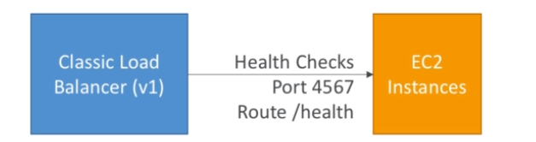
Health Checks
Crucial for Load Balancers
Super easy…just give a port and a route
If the response is not 200 then the instance is not healthy

Slide 37
Application Load Balancer (v2) (layer 7)
Load balancing to multiple HTTP applications across machines (target groups)
Load balancing to multiple applications in same machine (ex : containers)
Load balancing based on hostname in URL
They’re awesome for micro services and container based application (ex: Docker & Amazon ECS)
Port mapping feature to redirect to a dynamic port
In comparison, we would need one classic load balancer per application before. That was very expensive and inefficient

Slide 38
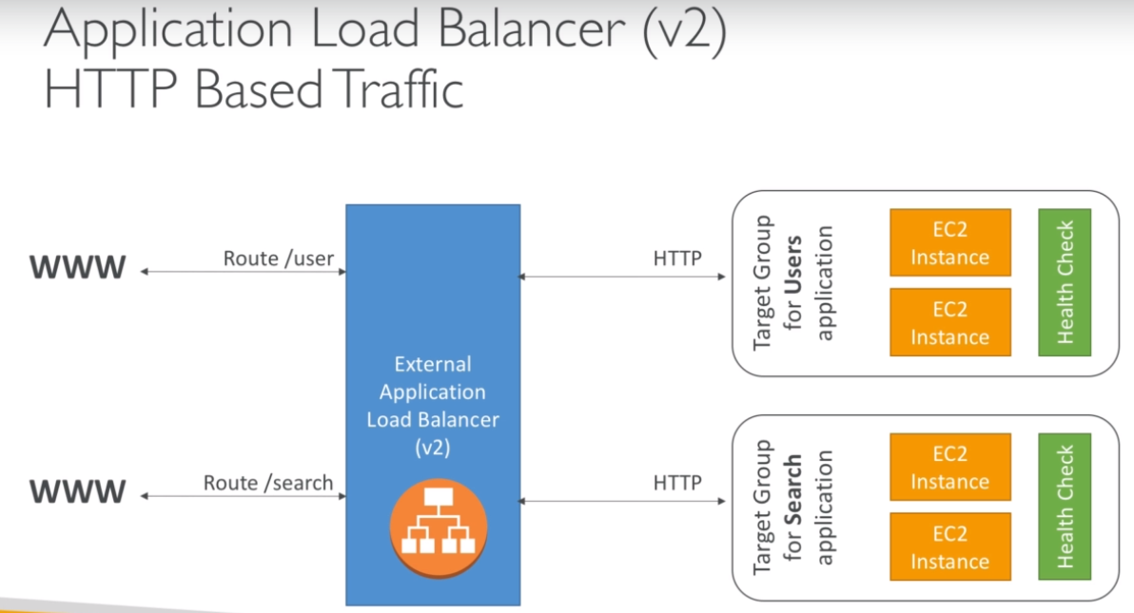

Slide 39
Stickiness can be enabled at the target group level
Same request goes to the same instance
Stickiness is directly generated by ALB (not the application)
ALB support HTTP/HTTPS & Websockets protocols
Application servers don’t see IP of client directly
True IP of the client is inserted in the header X-Forwarded-For
We can also get Port (X-Forwarded-Port) and proto (X-Forwarded-Proto)

Slide 40
Network Load Balancers
Operate at Layer 4
Forward TCP traffic to your instances
Can handle millions of requests per seconds
Support for static IP or elastic IP
Less latency ~ 100 ms (vs 400 ms for ALB)
Mostly used for extreme performance and should not be the default load balancer you choose
Creation is same as ALB

Slide 41
Good To Know
Classic Load Balancers are deprecated
Application Load Balancers for HTTP/HTTPs & Websocket
Network Load Balancer for TCP
CLB and ALB support SSL certificates and provide SSL termination
All Load Balancers have health check capability
ALB can route based on hostname/path
ALB is a great fit with ECS (Docker)
Any Load Balancer (CLB,ALB,NLB) has a static hostname. Do not resolve and use underlying IP
LBs can scale but not instantaneously → contact AWS for warm up
NLB directly see IP
4xx errors → client induced errors
5xx errors→ application induced errors
LB errors 503 → at capacity or no registered target
If LB cannot connect to your application check your security group

Slide 42
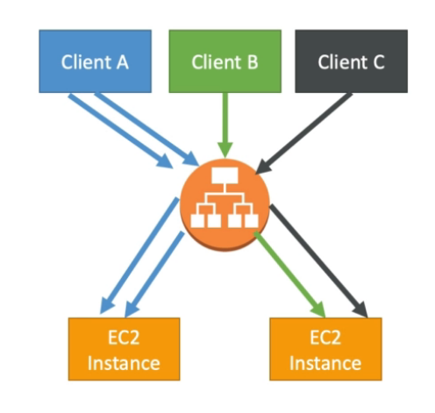
Load Balancer Stickiness
Possible to implement stickiness so that the same client is always redirected to the same instance behind a load balancer
Works for CLB and ALB
The cookie used for stickiness has an expiration date you control
Note → make sure the user doesn’t lose his session data
Enabling stickiness may bring imbalance to the load over the backend EC2 instances

Slide 43
LB for solution arch

Slide 44
Auto Scaling Group
Scale out (add ec2) to match increased load
Scale in (remove ec2) to match decreased load
Ensure we have a min and max number of instances running
Automatically register instances to LBs

Slide 45
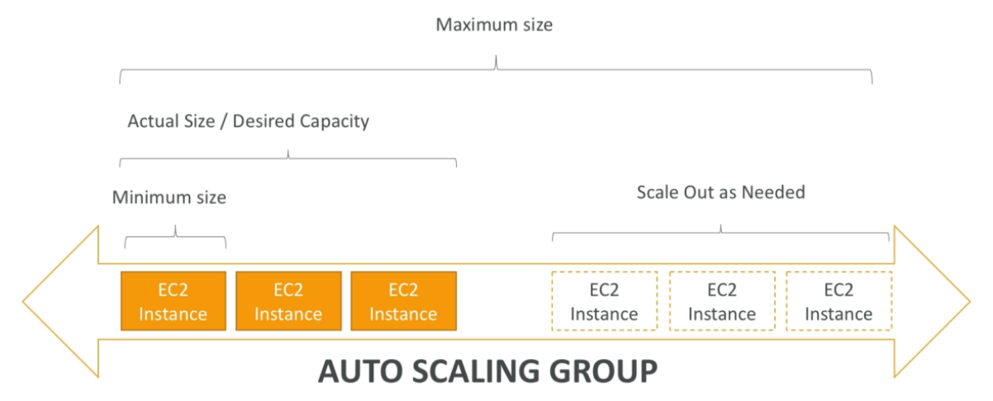
ASG in AWS

Slide 46
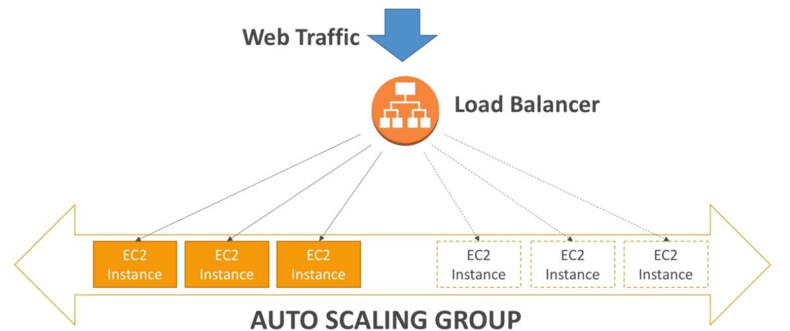
ASG in AWS with LB

Slide 47
ASG has the following attributes
A launch configuration
AMI + Instance type
EC2 User data
EBS Volumes
Security Groups
SSH Key Pair
Min Size/Max Size/ Initial Capacity
Network +Subnets information
Load Balancer Information
Scaling Policies

Slide 48
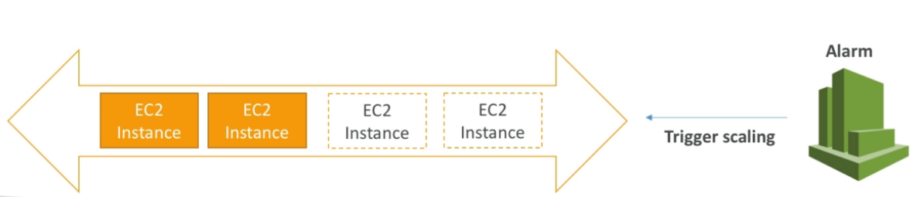
Auto Scaling Alarms
We can scale an ASG based on Cloudwatch alarms
An alarm monitors a metric (such as average CPU etc)
Metrics are computed for the overall ASG instances
Based on alarm: we can scale out/ scale in

Slide 49
ASG new rules
We can
Target Avg CPU Usage (scale in/out to meet avg CPU usage)
No. of requests on ELB per instance
Avg network in
Avg network out
These rules are easy to set up and can make more sense
Auto scaling with custom metric
Send custom metric from application on ec2 to cloudwatch using putmetric API
Create cloudwatch alarm to react to low/high values
Use cloudwatch alarm as the scaling policy for ASG

Slide 50
Summary for ASG
Scaling policy can be CPU, Network, custom metric or can be based on schedule
ASG use launch configurations and you updated ASG by providing new launch configuration
IAM roles attached to ASG will get attached to EC2 instances
ASG are free. We pay for underlying resources being launched
ASG can terminate instance if it is unhealthy

Slide 52
EBS
As EC2 loses it’s root volume (main drive) when terminated, we need a way to store the data.
EBS → network drive you can attach to your instances while they run
It allows instances to persist data
It’s a network drive ( not a physical drive)
Uses network to communicate with the instance i.e. there might be a bit of latency
Can be detached from an EC2 instance and attached to another quickly
Locked to an AZ → a volume created in us-east-1 cannot be attached to us-east-1b
But to move it across we need to create a snapshot
Get billed for the provisioned but not used capacity

Slide 53
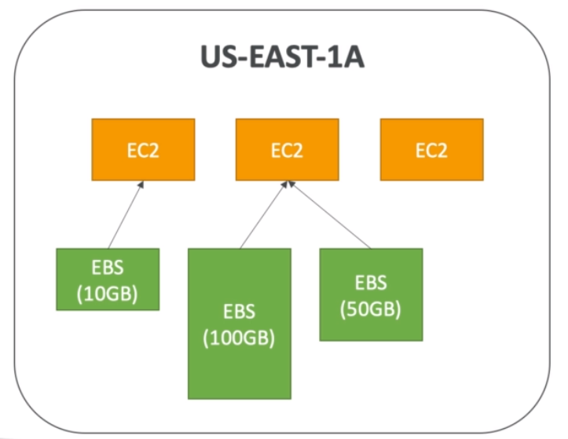
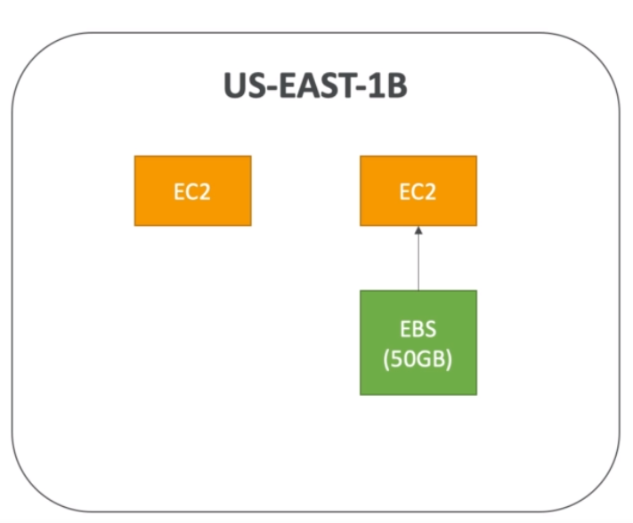

Slide 54
EBS Volume Types
4 Types:
GP2 (SSD): General purpose ssd volume that balances price and performance wide variety of workloads
IO1 (SSD) → Highest-performance SSD Volume for mission-critical low-latency or high throughput workloads
ST1 (HDD) → Low cost HDD volume designed for frequently accessed, throughput- intensive workloads
SC1 (HDD) → Lowest cost HDD volume designed for less frequently accessed workloads

Slide 55
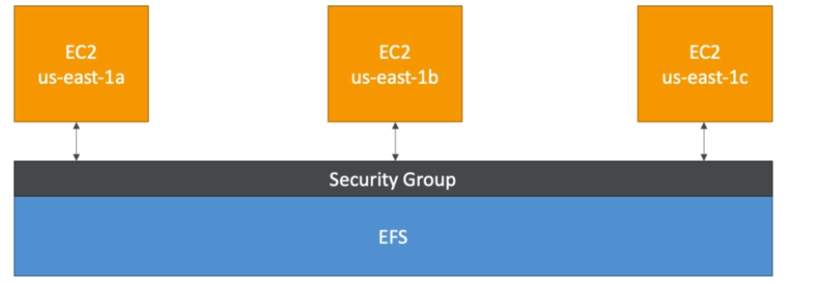
EFS → Elastic File System
Managed NFS (network file system) that can be mounted on many EC2
EFS works with EC2 instances in multi AZ
Highly available, scalable, expensive (3X GP2) but pay per use unlike EBS

Slide 56
Use cases
Content management, web serving, data sharing, wordpress
Uses standard NFSv4.1 protocol
We use security groups to control access to EFS network drive
It’s compatible with Linux based AMI (not windows)
Performance mode:
General purpose (default)
Max I/O → used when thousands of EC2 are using the EFS
EFS file sync to sync from on-premise file system to EFS
Backup EFS to EFS (incremental, can choose frequency)
Data encryption is by using KMS

Slide 57
RDS → Relational Database Service
Managed DB Service for DB use SQL
Allows us to create databases in the cloud that are managed by AWS
PostGres
Oracle
Mysql
Microsoft SQL Server
Aurora (AWS Proprietary database)
RDS vs DB in EC2
We get OS patching, continuous backup and restore
Restore to specific timestamps
Monitoring dashboards
Get read replicas if you want to improve read performance
Get multi availabilities on setups for disaster recovery
Maintenance windows for upgrades, scaling capability (vertically / horizontally)

Slide 58
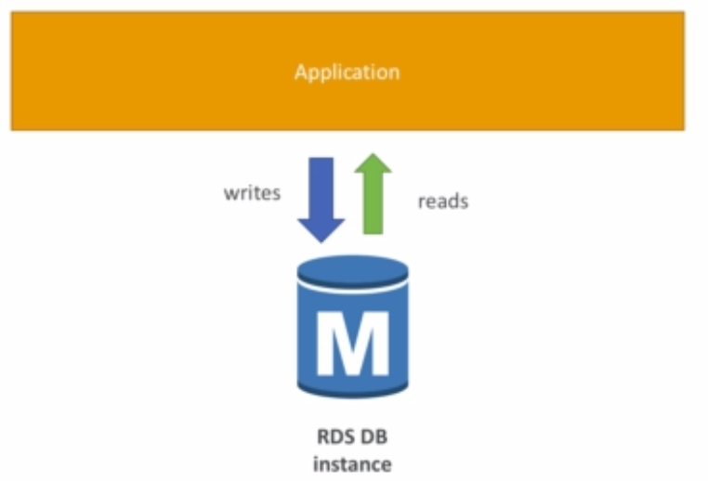
Can’t SSH into your RDS instances

Slide 59
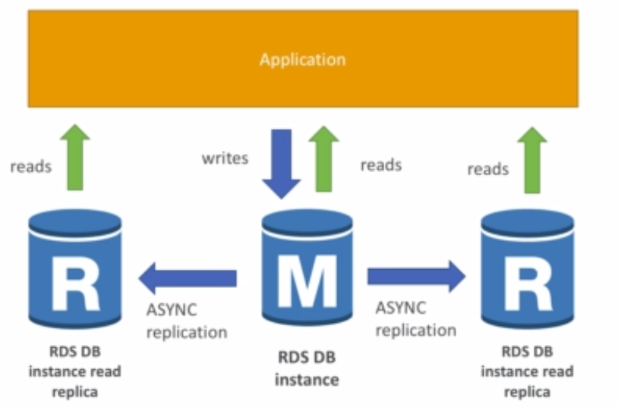

Slide 60
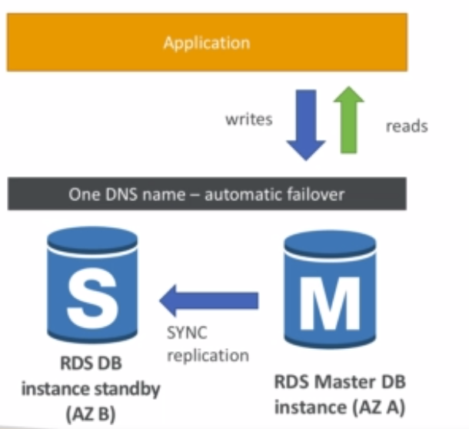
Replication is async and reads are eventually consistent
For RDS Multi AZ (Disaster recovery) → replication is synchronous

Slide 61
Backups are automatically enabled in RDS
Automated Backups:
Daily full snapshot of the database
Capture transaction logs in real time using which we can restore database to any checkpoint
By default retention policy for automated backups is 7 days can be till 35 days
DB Snapshots:
Manually triggered by user
Retention of backup for as long as you wish
RDS Encryption
Can be achieved by KMS keys or SSL Certificates
5x on mysql, 3x on Postgresql

